Slide 1

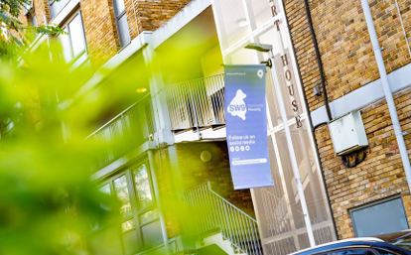
SW9 Community Housing
Resident Meeting – 9th June 2026
18:30-20:00

Slide 2
Agenda
Welcome & Introductions
Security Presentation
‘You Said We Did’ Presentation – March 2026
Refreshments and an opportunity to discuss individual issues with various members of SW9’s SLT and Staffing Team.

Slide 3
CCTV & Security Stockwell Park Estate
CCTV was originally installed over 25+ year ago via a government initiative, which partially funded the installation of CCTV
CCTV is monitored 24/7 (365 days of the year)
A phased upgrade is being undertaken with the old camera and recording system being upgraded to fully digital
This will also provide a simpler operating and recording system
By July 2026 there will be approx. 410 cameras on the SW9 estate, all recording 24/7

Slide 4
CCTV Management and Monitoring
CCTV is monitored within a purpose-built control room, in Park Heights.
The day-to-day monitoring is provided by the City Group, following a joint procurement process with SNG, they were appointed in December 2025.
Residents pay a weekly charge of £5.10 via their service charge
The CCTV work closely with SW9 in relation to ASB, criminal activity and capturing fly-tipping incidents.
CCTV Team and SW9 also work closely with the Safer Neighbourhood Team (Police)

Slide 5
ASB and Criminal Activity
There has been an increase in ASB and criminal behaviour, partially due to the increased activity in the centre of Brixton, which has moved some of the nuisance onto the SW9 estate.
There are monthly security meetings which SW9, Local Police and City Group attends to discuss hotspots, specific incidents and share information.
Serious incidents are immediately acted upon.
SW9 are currently in discussion with LB Lambeth, so that both Lambeth and SW9’s CCTV system can be linked to monitor seamlessly nuisance and criminal activity

Slide 6
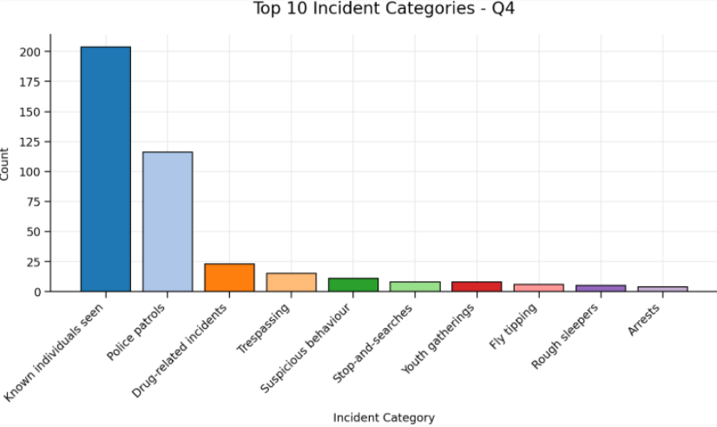
Top 10 incidents reported by CCTV across the estate

Slide 7
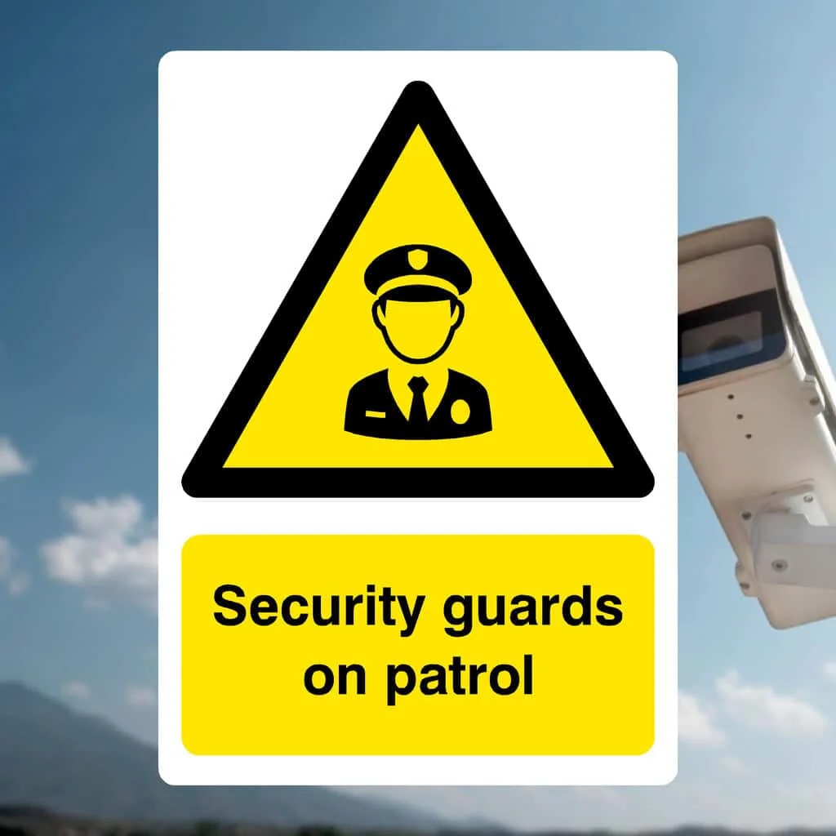
Security Patrols on SW9 Estate
City Group also provide the security patrols on the estate, which is normally three days per week, the rota and timings are reviewed weekly and will be changed dependent on incidents/issues raised.
There has been an increase in anti social behaviour, as such there is a trial to increase the patrols to five days per week.
If the security patrol is not on call, residents can call XXX leave a message, this is monitored by the supervisor of the CCTV control room who will pick up the message and liaise with their team to monitor and take necessary action in the absence of the patrol team
Residents pay £0.79p per week via their service charge

Slide 8
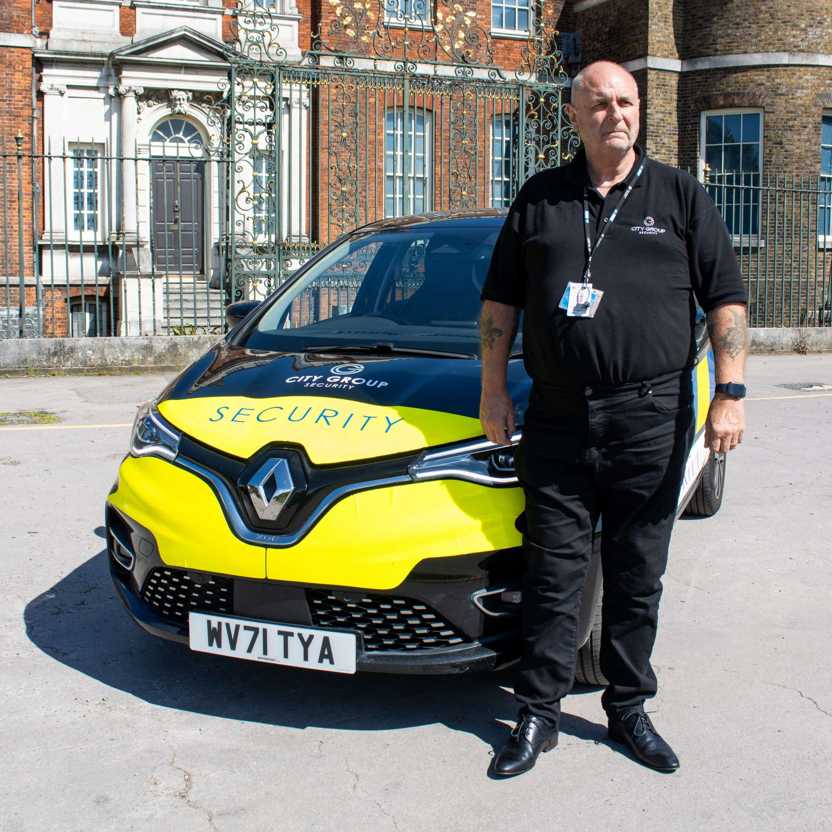
Security Patrols continued
The Security Patrol are a deterrent, they provide daily reports to SW9 which highlight where there have been issues include rough sleeping, drug taking, groups congregating, and what action they have taken including moving on rough sleepers, drug users and groups congregating and liaise with the CCTV room and police where necessary.
Where residents have raised issues, they will include these areas in their next patrol.
They also undertake weapon sweeps and patrol the under crofts.

Slide 9
Any questions?

