Slide 1
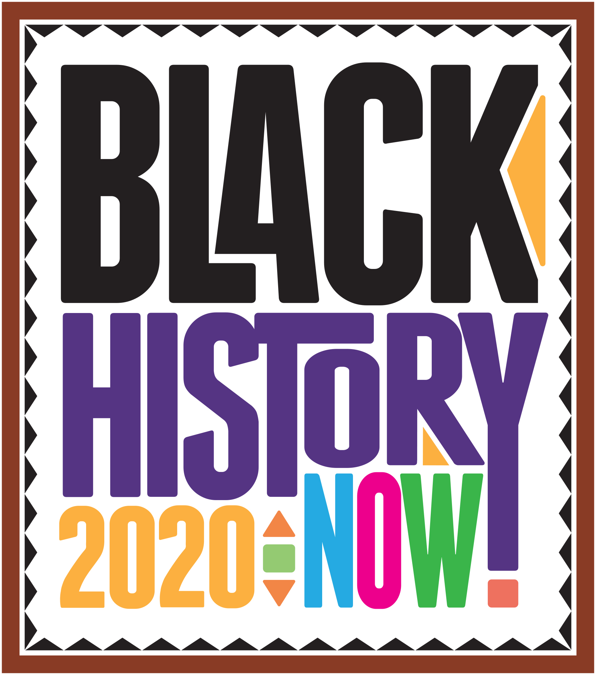

Slide 2
BLACK AND INDIAN VICTORIANS

Slide 3
William Cuffay
1788 – 1870
William Cuffay the son of a former slave, was a leading figure in the Chartist movement, an important political movement in Britain. He was transported to Australia for allegedly planning an uprising against the British government.
William Cuffay was born in the West Indies in 1788, the son of a naval cook and former slave. His family later settled in Kent.
Cuffay believed that workers should be allowed to vote (in those days only the very rich could vote.) He campaigned for workers to have the right to vote, and soon became an important figure in the Chartist movement in London.
In the summer of 1848 Cuffay became involved in a plan to lead an armed uprising against the government. Based on the evidence of a government spy, Cuffay was arrested and convicted for preparing to set fire to certain buildings. He was sentenced to be transported to Tasmania for 21 years.
Three years later all political prisoners in Tasmania were pardoned but Cuffay decided to remain, carrying on his trade as a tailor and again becoming involved in politics there. He died in poverty in July 1870.

Slide 4
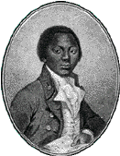
Oludah Equiano
1745 - 1797
Olaudah Equiano, the first political leader of Britain's black community was born in the kingdom of Benin (west Africa), in 1745. When he was about eleven, Equiano was kidnapped along with his sister, and after six months of captivity he was brought to the coast of Africa where he saw white men for the first time.
Sold to slave-traders, Equiano was transported to Barbados. He was purchased by a British naval officer. He was renamed Gustavas Vassa and was beaten until he answered to his new name.
His master sent him to London. There he stayed with relatives of his master, who taught him to read and sent him to school.
He was then sold to a merchant called Robert King in the West Indies. Equiano saved whatever money he could, and in 1766 bought his freedom. In 1767 he went back to London and worked in the Society for the Abolition (banning) of the Slave Trade.
Equiano published his own autobiography, The Life of Olaudah Equiano the African in 1789, 'a detailed account of an African's movement out of slavery', It became a bestseller and was also published all over the world, and people were horrified to hear of the life of a slave.
He made and outstanding contribution to the struggle to abolish slavery.

Slide 5
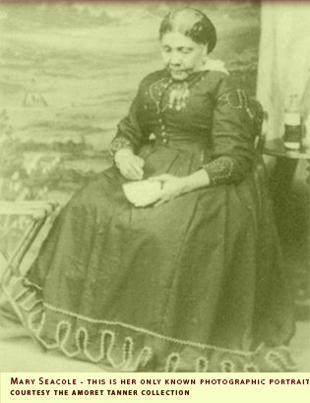
Mary Seacole
1805 – 1881
Seacole was a heroine of the Crimean War, who as a woman of mixed race overcame prejudice.
She was born in Kingston, Jamaica in 1805. Her father was a Scottish soldier, and her mother a Jamaican. Mary learned her nursing skills from her mother, who kept a boarding house for invalid soldiers.
Mary loved to travel, and visited Cuba, Haiti and the Bahamas, as well as Central America and Britain. On these trips she built up a knowledge of medical methods. In 1854 Seacole traveled to England again, and approached the War Office, asking to be sent as an army nurse to help in the Crimean war, where there were poor medical facilities for wounded soldiers. She was refused. Seacole paid for her own trip to the Crimea where she established the British Hotel to provide ‘comfortable quarters for sick officers'. She also visited the battlefield, sometimes under fire, to nurse the wounded.
Seacole died on 14 May 1881.

Slide 6
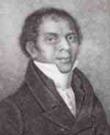
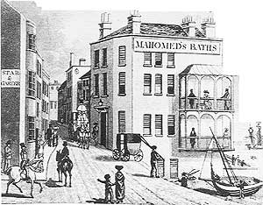
Sake Dean
Mohamed
Dean Mohamed (1759-1851) grew up in India. He served in the English Bengal Army as a surgeon.
At age 25 he immigrated to Ireland in 1786, where he wrote and published his book, entitled 'The Travels of Dean Mahomet'. He became the first Indian to write a book in English.
Sake Dean Mahomed moved to London, where he opened the first Indian take away restaurant in England - the Hindustani Coffee House.
Then, in 1814 Dean and Jane, his Irish wife, moved to Brighton and opened a public bath-house, the first of its kind in England. It was supposed to cure aches and pains.
The bath-house was very popular, and both King George IV and William IV were among Sake’s customers

Slide 7
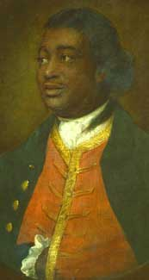
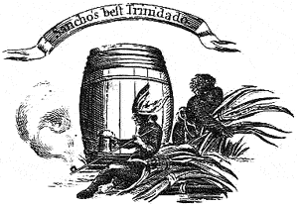
Ignatius Sancho
1729 - 1780
Ignatius Sancho was born on a slave on a ship crossing the Atlantic from Africa to the West Indies. His earliest memories were of Greenwich, near London, where he worked as a child slave. He later ran a grocery shop in Westminster.
He composed music, appeared on the stage, and entertained many famous figures in London.
He was the first African to vote in a British election.
For those campaigning for slavery to be abolished, Sancho was an important example of how Africans were just as intelligent as white people.
After Sancho’s death, a set of his writings were published prompting one reviewer to write, "let it no longer be said by half informed philosophers, that black people are inferior to any white nation in mental abilities".

